Slide 1


Objectives
In this session, you will learn to:
  Introduce canvas
  Transform and animate canvas elements

Slide 2
Introducing Canvas
  Use the animation, HTML_06_Canvas.swf, to understand the
  concept of canvas.

Slide 3
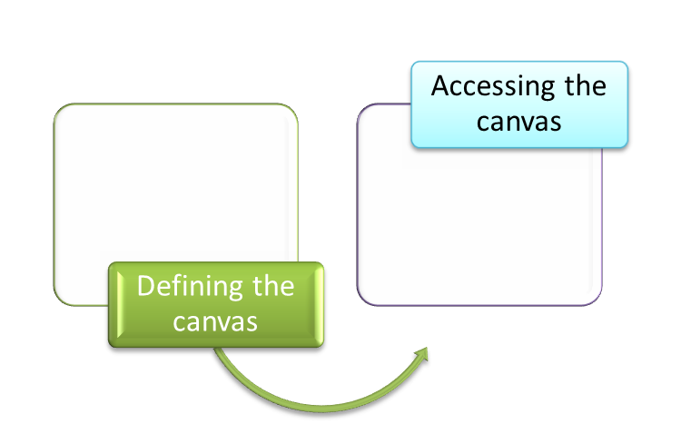
Creating a Canvas
A canvas:
  Provides an easy and a powerful way to create graphics on a Web page.
  Is an area that acts as a container for embedding graphic objects.
  Allows dynamic rendering of bitmap images by using JavaScript.
  Can be used for drawing graphics by performing the following tasks:

Slide 4
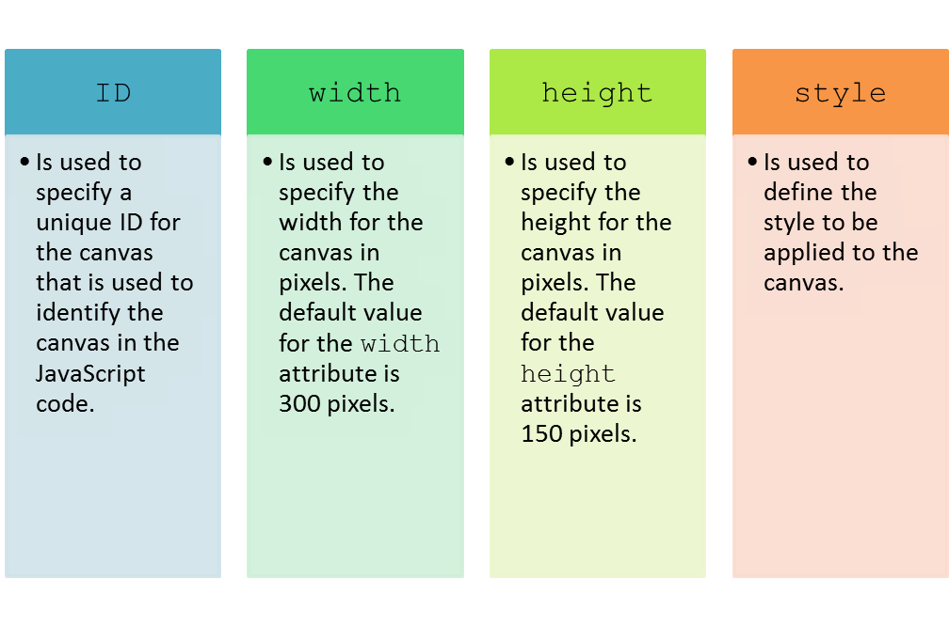
Creating a Canvas (Contd.)
  Is defined by using the <CANVAS> tag having the following attributes:

Slide 5
Creating a Canvas (Contd.)
  A canvas can be accessed in the JavaScript code using the following methods:
  getElementById()
  getContext()
  For example:
  <SCRIPT>
    var c=document.getElementById("myCanvas");
    var ctx=c.getContext("2d");
    </SCRIPT>

Slide 6
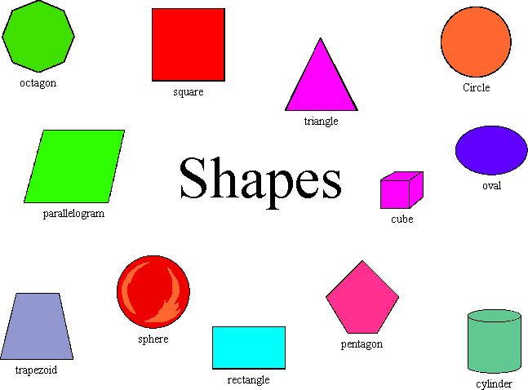
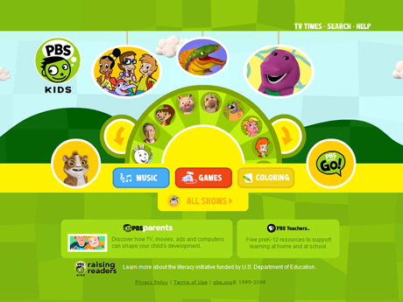
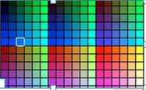
Working with Color, Shapes, and Styles
Scenario:
Provides online applications to draw shapes and fill colors on the canvas objects

Slide 7
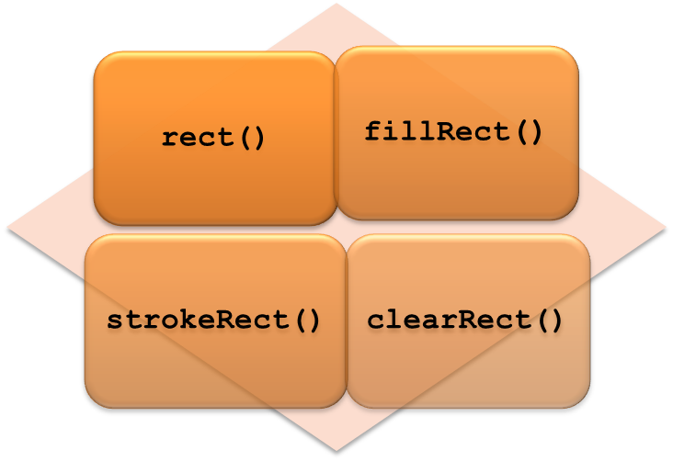
Working with Color, Shapes, and Styles (Contd.)
  You can draw shapes, such as rectangle and square, on a canvas using
  the following methods:

Slide 8
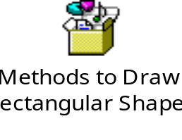
Working with Color, Shapes, and Styles (Contd.)
  The following embedded Notepad file contains the code to draw rectangular shapes on a canvas:
Use the animation, HTML_06_ClearRect.swf, to understand the use of clearRect()method.

Slide 9
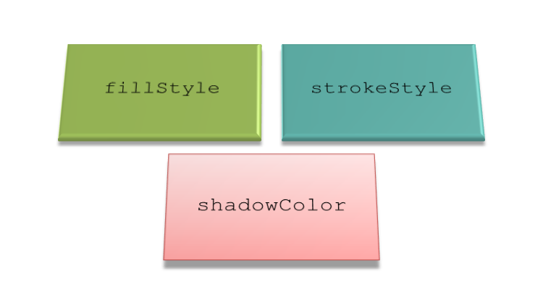
Working with Color, Shapes, and Styles (Contd.)
You can use the following properties to apply colors on the graphic objects
that are drawn inside the canvas:

Slide 10
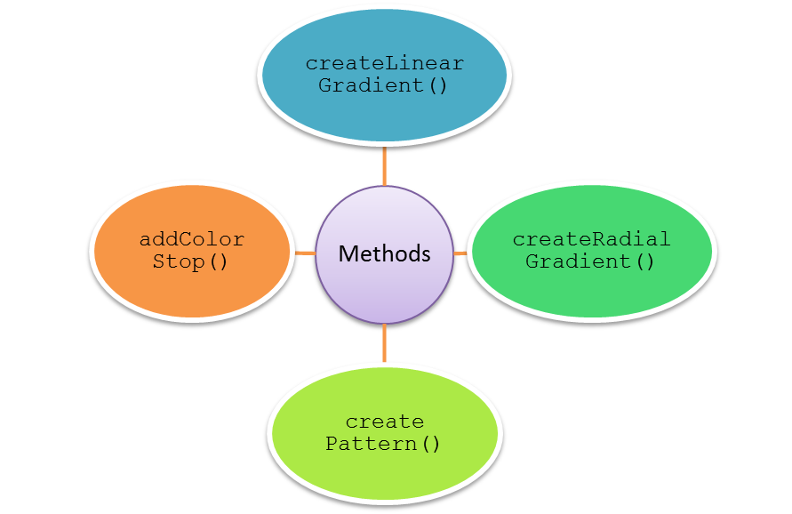
Working with Color, Shapes, and Styles (Contd.)
  You can also use gradients to apply styles on the graphic objects drawn
  inside the canvas.
  A gradient is an object that provides smooth transition between two or
  more colors.
  You can use the following methods to work with gradient styles:

Slide 11
Just a Minute
Which one of the following methods can be used to remove a certain portion of the
rectangle on the canvas?
  rect()
  createRect()
  strokeRect()
  clearRect()

Slide 12
Just a Minute (Contd.)
Solution:
  clearRect()

Slide 13
Working with Path, Text, and Images
A path:
  Is a series of points joined together to create lines or shapes.
  Is used to create shapes, such as circles, polygons, or triangles.
  You need to use the following methods to create shapes using path:
  fill()
  stroke()
  beginPath()
  moveTo()
  closePath()
  lineTo()
  clip()
  arc()
  arcTo()

Slide 14
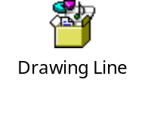
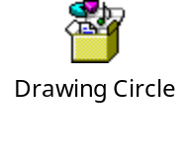
Working with Path, Text, and Images (Contd.)
  The following embedded Notepad file contains the code to draw a line on a canvas:
  The following embedded Notepad file contains the code to draw a circle on a canvas:

Slide 15
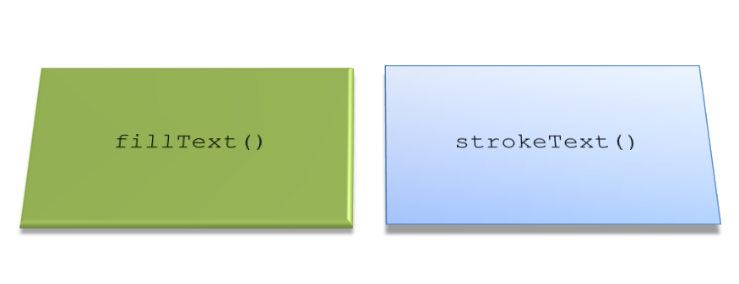
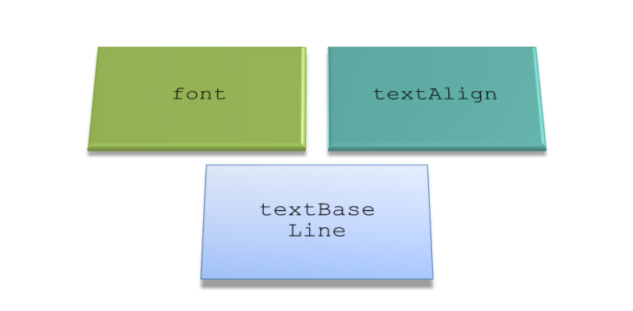
Working with Path, Text, and Images (Contd.)
You can draw text on the canvas using the following methods:
  You can also apply styles on the text using the following properties:

Slide 16
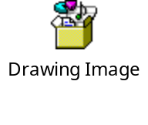
Working with Path, Text, and Images (Contd.)
The drawImage() method is used to draw an image or a video on the canvas.
To define the drawImage() method, you can use the following syntaxes:
drawImage(img,x,y);
    drawImage(img,x,y,width,height);
    drawImage(img,sx,sy,swidth,sheight,x,y,width,height);
    The following embedded Notepad file contains the code to draw an image
    on a canvas:

Slide 17
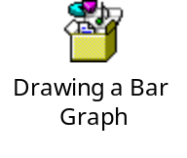
Working with Path, Text, and Images (Contd.)
A graph is a way of representing relationships among a collection of items.
Canvas can also be used to create graphs.
The creation of graphs has been simplified by using the freely-downloadable
JavaScript library named RGraph.
This library needs to be referenced in the Web page using the following syntax:
<SCRIPT type="text/javascript" src="<RGraph_file_name>">
    </SCRIPT>
    The following embedded Notepad file contains the code to draw a bar graph
    on a canvas:

Slide 18
Just a Minute
Which one of the following methods is used to draw the outline of the path on
the canvas?
  fill()
  stroke()
  lineTo()
  moveTo()

Slide 19
Just a Minute (Contd.)
Solution:
  stroke()

Slide 20
Demo: Introducing Canvas
Problem Statement:
  The form for booking movie tickets has been created on the Online Booking Web page. Now, you want to display the movie ratings to the audience on that page. The movie ratings on the latest movies should be displayed in the form of bar graphs. The rating should be given on the scale of 1 – 5, where 1 stands for Below Average and 5 stands for Extraordinary.
  How will you perform this task?
  Prerequisite: To perform this activity, you need to use the ShowOnWheels file that you have created in Activity 5.2. In addition, you need the RGraph.bar.js and RGraph.common.core.js files and save them in the ShowOnWheels folder. Ask your faculty to provide you the same.

Slide 21
Demo: Introducing Canvas (Contd.)
Solution:
  To display the movie ratings in the form of a bar graph, you need to perform
  the following tasks:
  1. Update the OnlineBooking.html file.
  2. View the movie ratings.

Slide 22
Transforming and Animating Canvas Elements
You may need to make the objects added inside the canvas visually appealing.
You may also want to apply animation effects on these objects.
This can be implemented by transforming graphic objects drawn on the canvas.

Slide 23
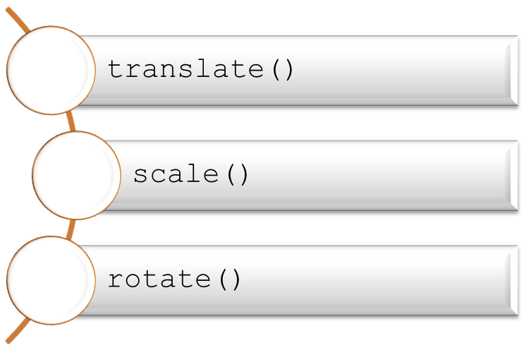
Transforming Canvas Elements
The canvas elements are transformed:
  To shift them from one position to another.
  To increase or decrease their size.
  Using the following methods:

Slide 24
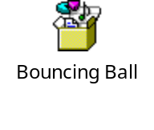
Animating Canvas Elements
An animation:
  Is a visual technique that provides the illusion that an object is moving.
  Is created by displaying the graphic objects in a rapid sequence.
  Can be created by performing the following steps:
    1. Creating a variable for the animation state.
    2. Drawing the animation.
    3. Redrawing the objects.
    The following embedded Notepad file contains the code to create a bouncing ball
    on the canvas:

Slide 25
Summary
In this session, you learned that:
  A canvas provides an easy and a powerful way to create graphics on a Web page.
  A canvas is defined by using the <CANVAS> tag. This tag is defined in the body section of the HTML document.
  You can use the following methods to draw shapes on canvas:
    rect()
    fillRect()
    strokeRect()
    clearRect()
  The following properties can be used to apply colors on the canvas objects:
    fillStyle
    strokeStyle
    shadowColor
  Apart from creating simple shapes on the canvas, you can also apply styles, such as gradients, on them.

Slide 26
Summary (Contd.)
  A path is a series of points joined together to create lines or shapes. In a canvas, you can use lines or paths to draw shapes other than rectangles or squares.
  In addition to drawing shapes or lines on the canvas, you can also draw text on it. You can also apply different styles on the text.
  The drawImage() method is used to draw an image or a video on the canvas.
  In a canvas, you can create graphs, such as bar graph or pie chart, to represent relationships.
  To transform the canvas elements, you can use the following methods:
    translate()
    scale()
    rotate()
  To create animations on the canvas, you need to perform the following steps:
    1. Create a variable for the animation state.
    2. Draw the animation.
    3. Redraw the objects.

